Slide 1
Capstone Project 2: Topic Model Analysis of Berkshire Hathaway’s Annual Letters to Shareholders
Springboard Capstone Project II
Tom Halloin

Slide 2
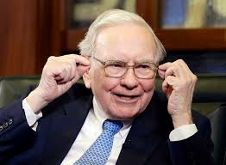
Advice from Warren Buffett
“Read 500 pages every day. That's how knowledge works. It builds up, like compound interest. All of you can do it, but I guarantee not many of you will do it.”

Slide 3
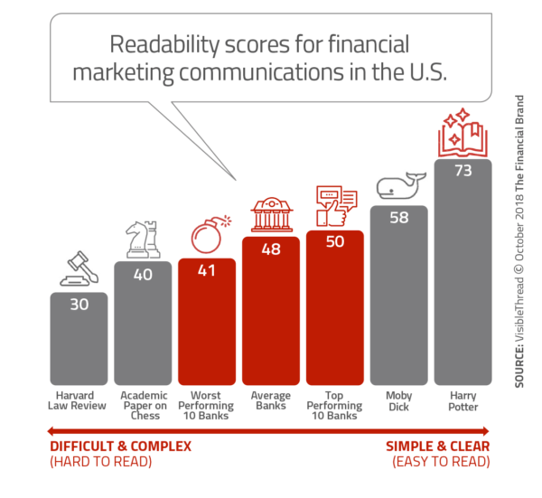
The Problem
Financial literature is long, confusing, and boring to most people.
Solution: summarize documents and build a topic model using machine learning.
Source: The Financial Brand

Slide 4
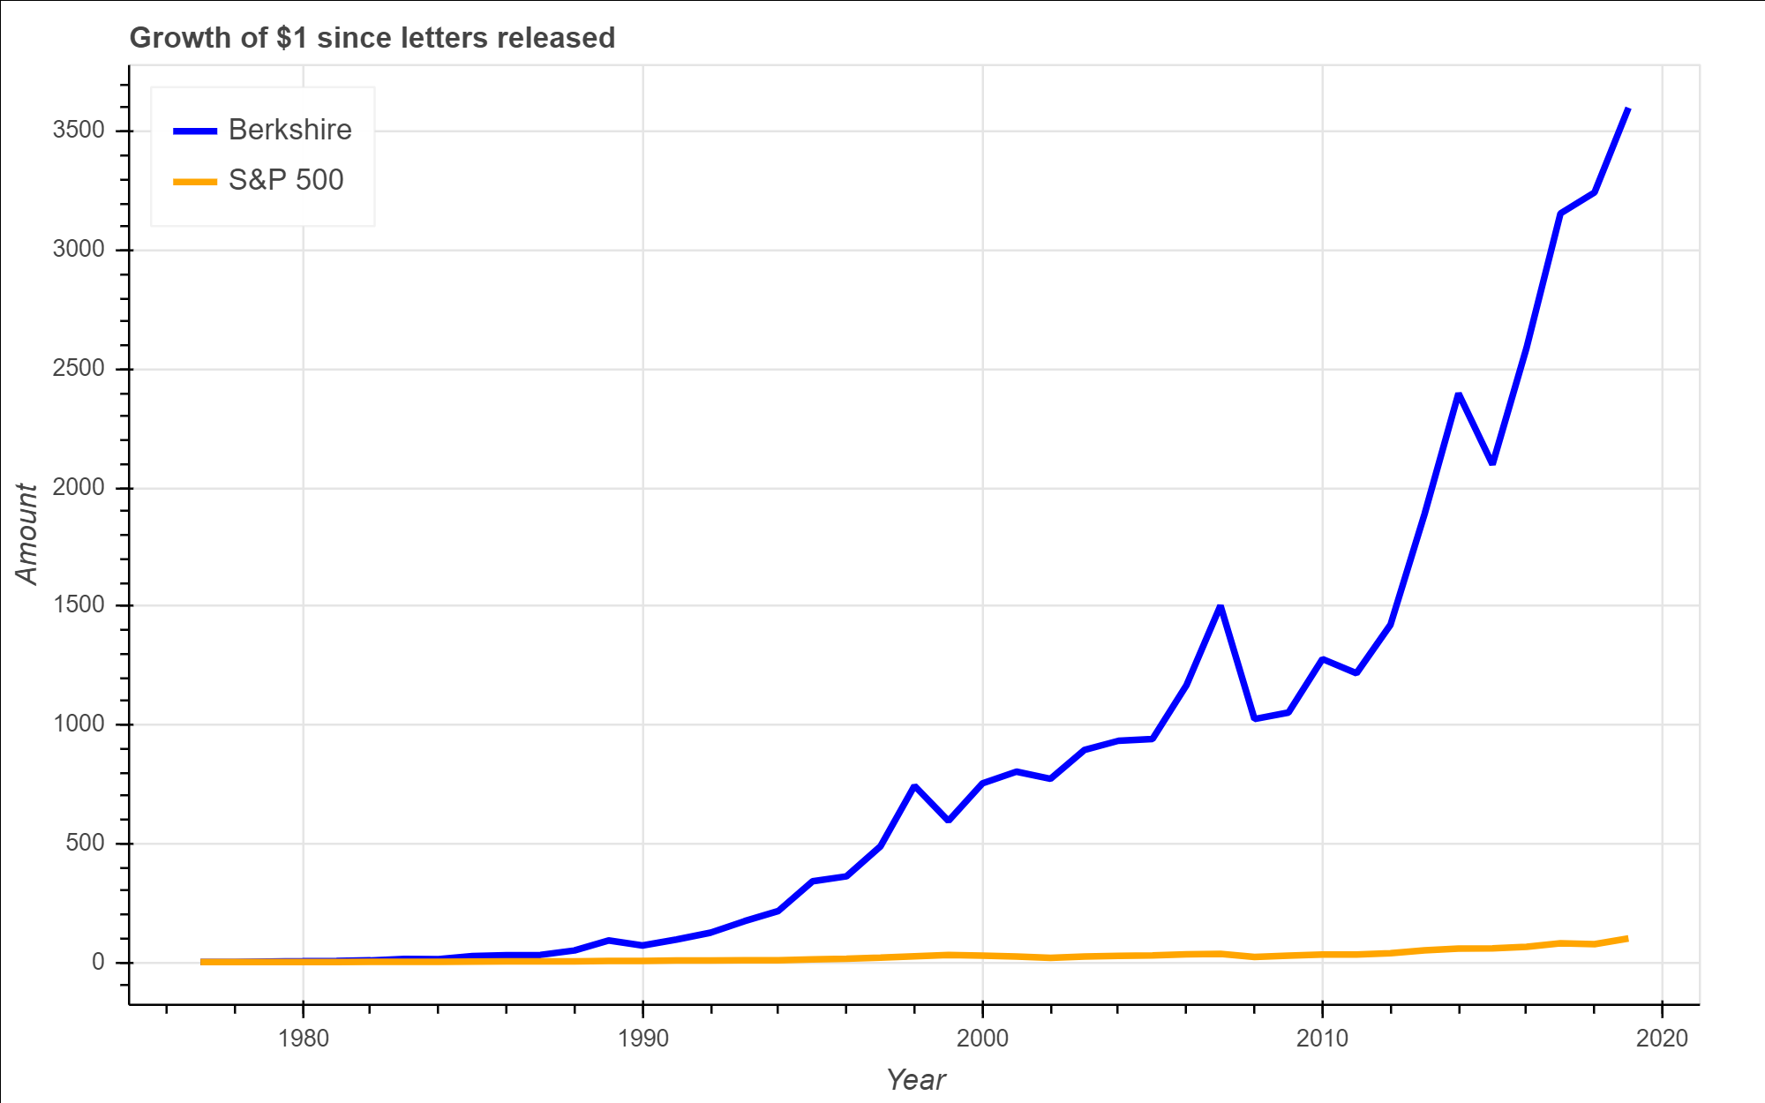
Case study: Berkshire Hathaway
Berkshire Hathaway is a holding company run by Warren Buffett.
Berkshire’s returns have trounced the S&P 500 since releasing letters in 1977.
Dataset: 43 letters, 500,000 words, readability level of 58.

Slide 5
Exploration Libraries: SpaCy and Textacy
SpaCy is an open-sourced library used to tokenize, parse, and tag text data.
Textacy is built on Spacy and does pre- and post- processing for Spacy, including cleaning text, generating text statistics, and creating n-grams.

Slide 6
Acquiring, Cleaning, and Wrangling the Data
Letters dating back to 1977 are on Berkshire’s website in HTML and PDF files.
Challenges:
Reading files from different formats.
Splitting PDF files in order to parse information.
Getting past spam blockers for multiple years.

Slide 7
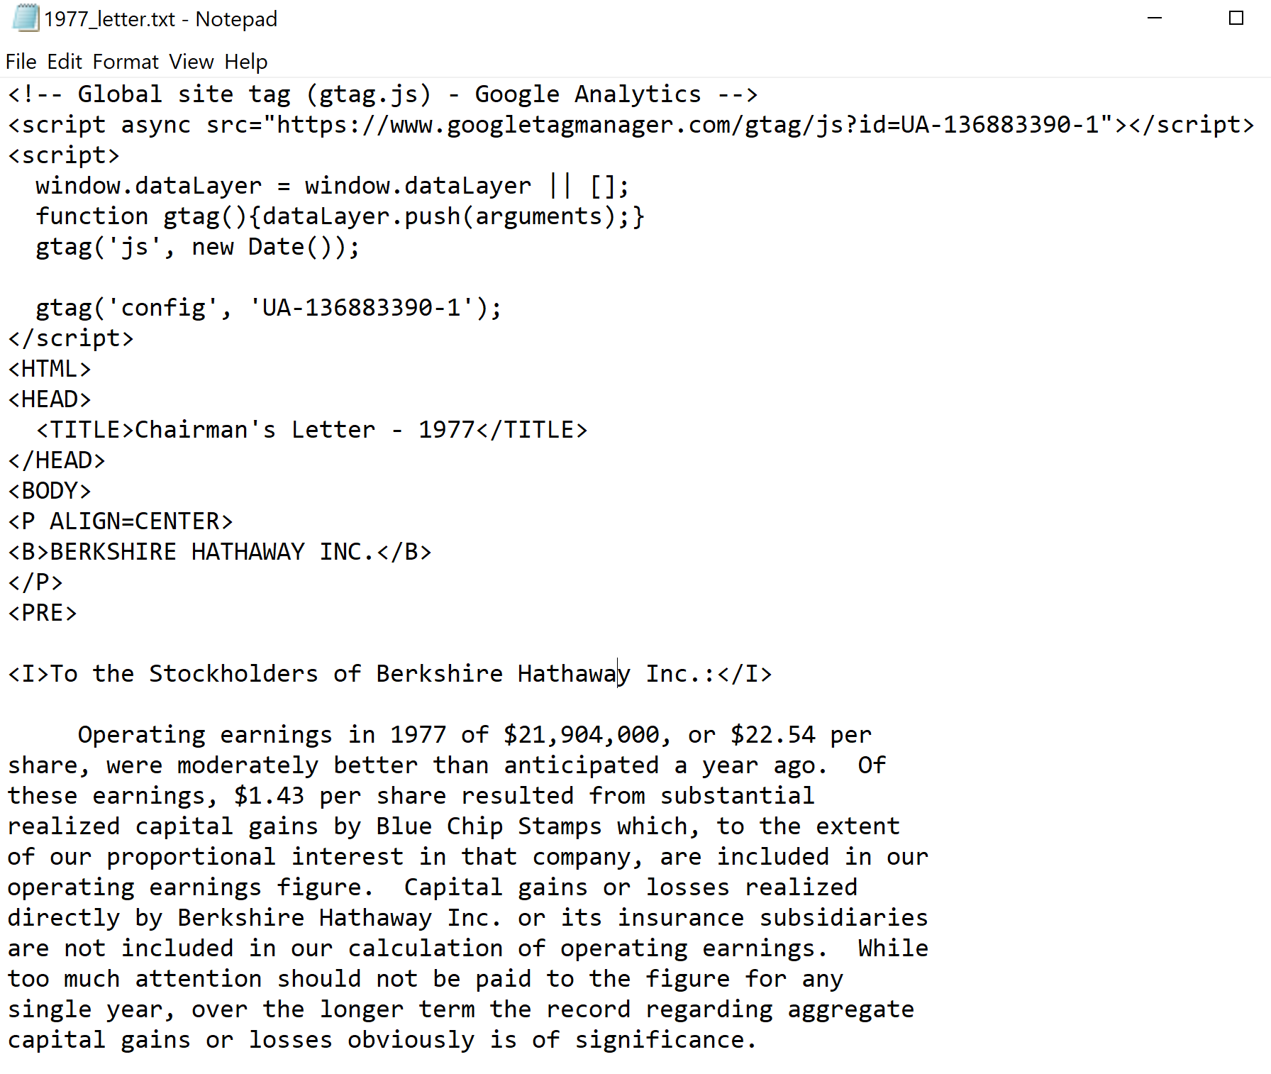
Cleaning Letters for Humans
Removing HTML
Removing text not in original letters
Removing symbols
UTF-8 encodings
Tabular data

Slide 8
Summarizing the Documents
Three different summarizers: LexRank, TextRank, LSA.
Use each method to find the top 5 sentences for each year and compare across years and summarization methods.

Slide 9
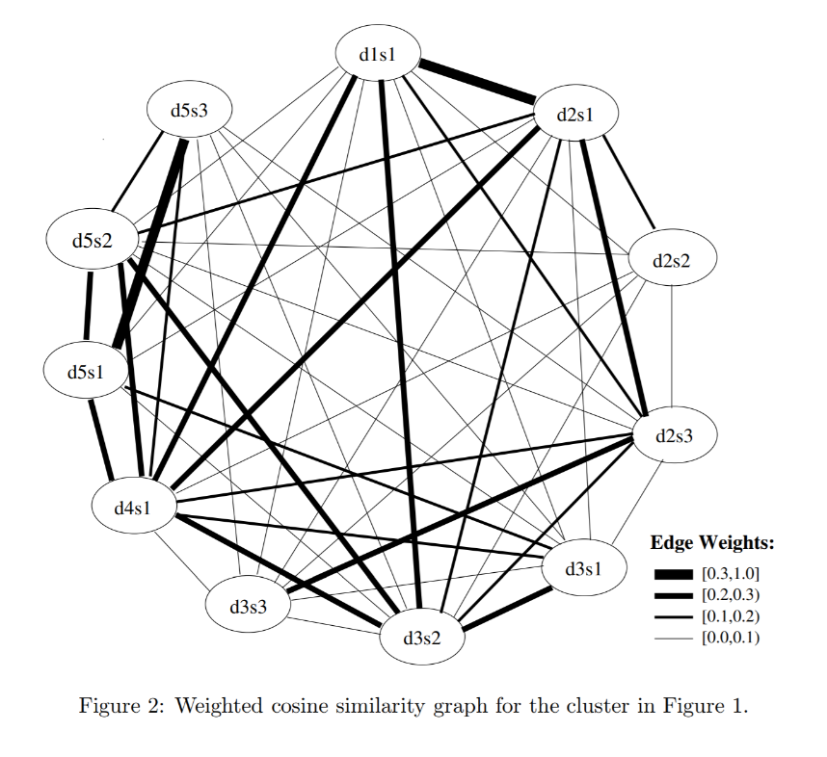
Comparing Summarizations: LexRank
Finds the most relevant sentences by using weighted cosine similarities of TF-IDF vectors.
Graph based ranking model similar to Google’s PageRank algorithm.

Slide 10
LexRank, the ugly
“Berkshire's Share of Undistributed Berkshire's Approximate Operating Earnings Berkshire's Major Investees Ownership at Yearend (in millions) 1993 1992 1993 1992 Capital Cities/ABC, Inc. 13.0% 18.2% $ 83(2) $ 70 The Coca-Cola Company 7.2% 7.1% 94 82 Federal Home Loan Mortgage Corp. 6.8%(1) 8.2%(1) 41(2) 29(2) GEICO Corp. 48.4% 48.1% 76(3) 34(3) General Dynamics Corp. 13.9% 14.1% 25 11(2) The Gillette Company 10.9% 10.9% 44 38 Guinness PLC 1.9% 2.0% 8 7 The Washington Post Company 14.8% 14.6% 15 11 Wells Fargo & Company 12.2% 11.5% 53(2) 16(2)” – 1993 letter

Slide 11
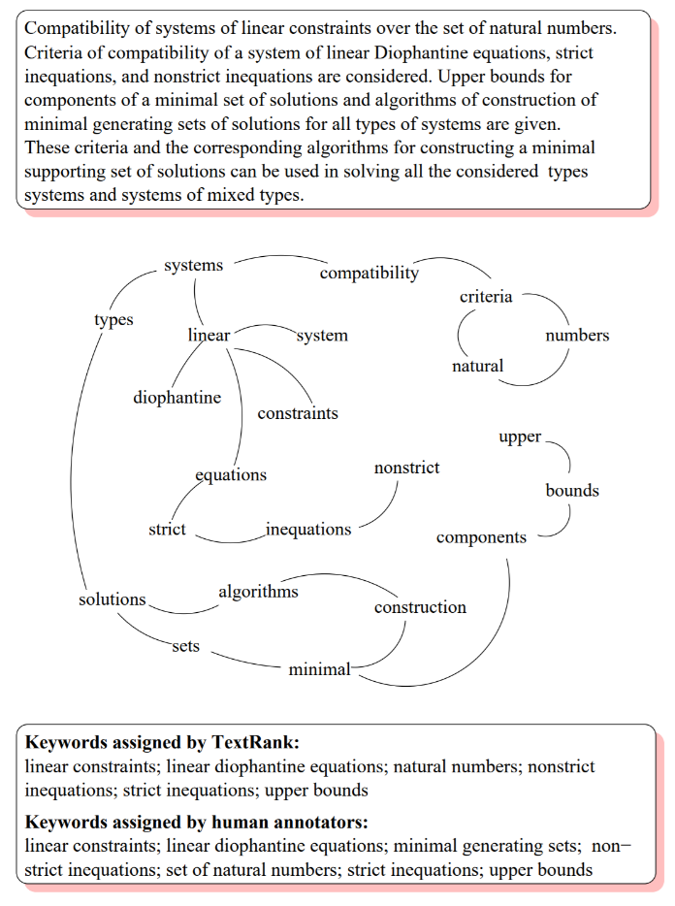
Comparing Summarizations: TextRank
Almost the same as LexRank, with the exception of different weights (log based).
Weighs sentences based on the number of words two sentences have in common.

Slide 12
TextRank, the ugly
Loading time was by far the longest of the three methods.
“Berkshire's Share of Undistributed Berkshire's Approximate Operating Earnings Berkshire's Major Investees Ownership at Yearend (in millions) 1991 1990 1991 1990 Capital Cities/ABC Inc. 18.1% 17.9% $ 61 $ 85 The Coca-Cola Company 7.0% 7.0% 69 58 Federal Home Loan Mortgage Corp. 3.4%(1) 3.2%(1) 15 10 The Gillette Company 11.0% 23(2) GEICO Corp. 48.2% 46.1% 69 76 The Washington Post Company 14.6% 14.6% 10 18 Wells Fargo & Company 9.6% 9.7% (17) 19(3) Berkshire's share of undistributed earnings of major investees $230 $266 Hypothetical tax on these undistributed investee earnings (30) (35) Reported operating earnings of Berkshire 316 371 Total look-through earnings of Berkshire $516 $602 (1) Net of minority interest at Wesco (2) For the nine months after Berkshire converted its preferred on April 1 (3) Calculated on average ownership for the year We also believe that investors can benefit by focusing on their own look-through earnings.”

Slide 13
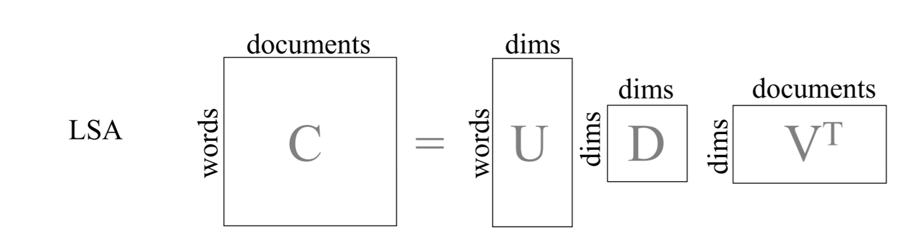
Comparing Summarizations: LSA
LSA creates a term-document matrix consisting of word frequencies for each term in each document.
Uses singular value decomposition to find most important sentences.

Slide 14
LSA, the ugly
“You only learn who has been swimming naked when the tide goes out and what we are witnessing at some of our largest financial institutions is an ugly sight.”
– 2007 letter

Slide 15
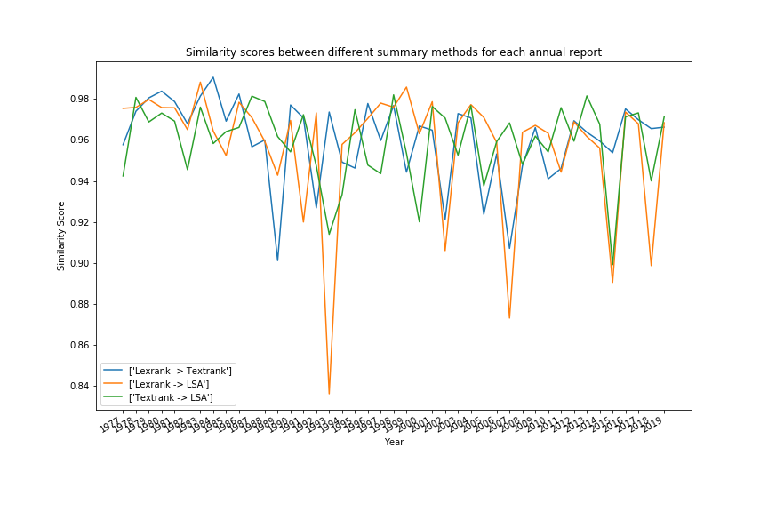
Overall, summaries were fairly similar and did a good job summarizing.

Slide 16
Selecting Appropriate Algorithms
This is an unstructured dataset.
We are not trying to predict categories or quantities.
In this case, look for clustering algorithms.
For text data, this means topic modeling.

Slide 17
Topic Modeling Methods and Libraries
Latent Dirichlet Allocation (LDA) tries to separate sets of observations into groups to explain similarity within the groups.
Gensim LDA is an LDA implementation designed to provide an approximation to large datasets.
Mallet LDA is similar to Gensim, but uses Gibbs Sampling to create evenly-distributed topics. Needs Java for extra processing power.

Slide 18
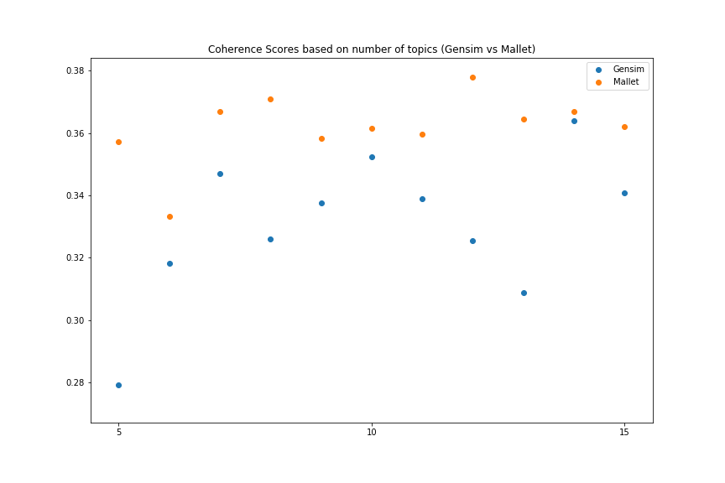
Measure Topic Quality: Coherence Score

Slide 19
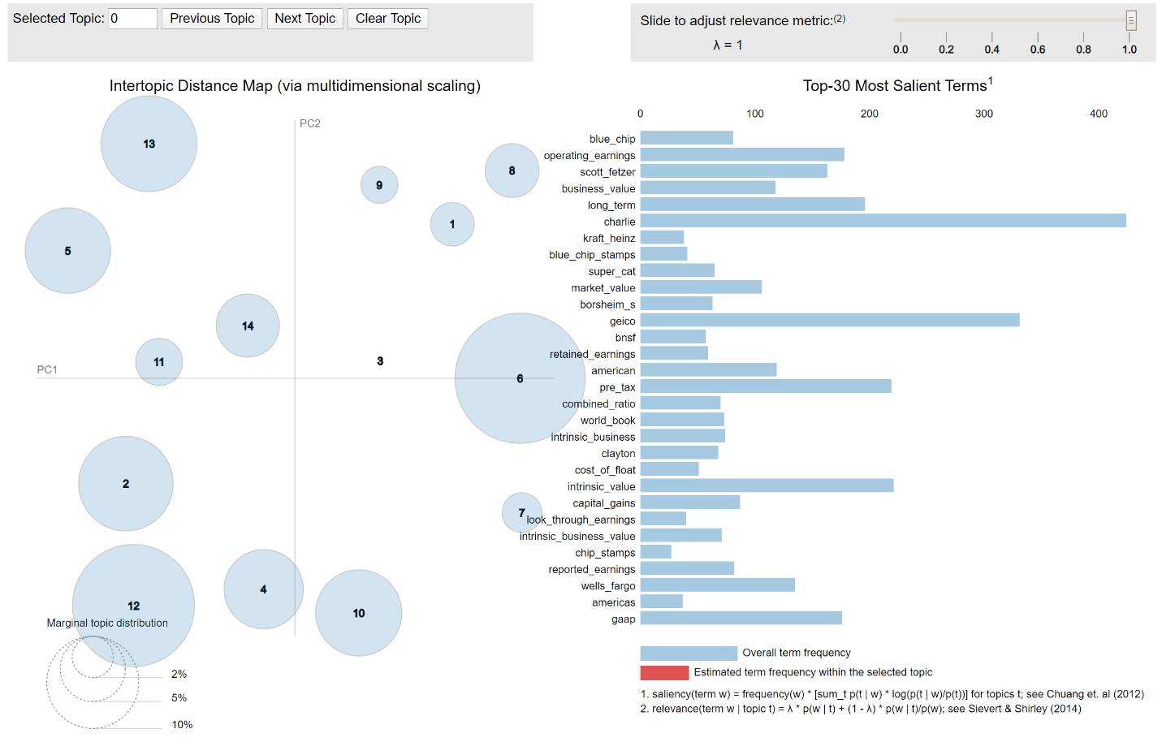
Sample Topic Model - GensimLDA

Slide 20
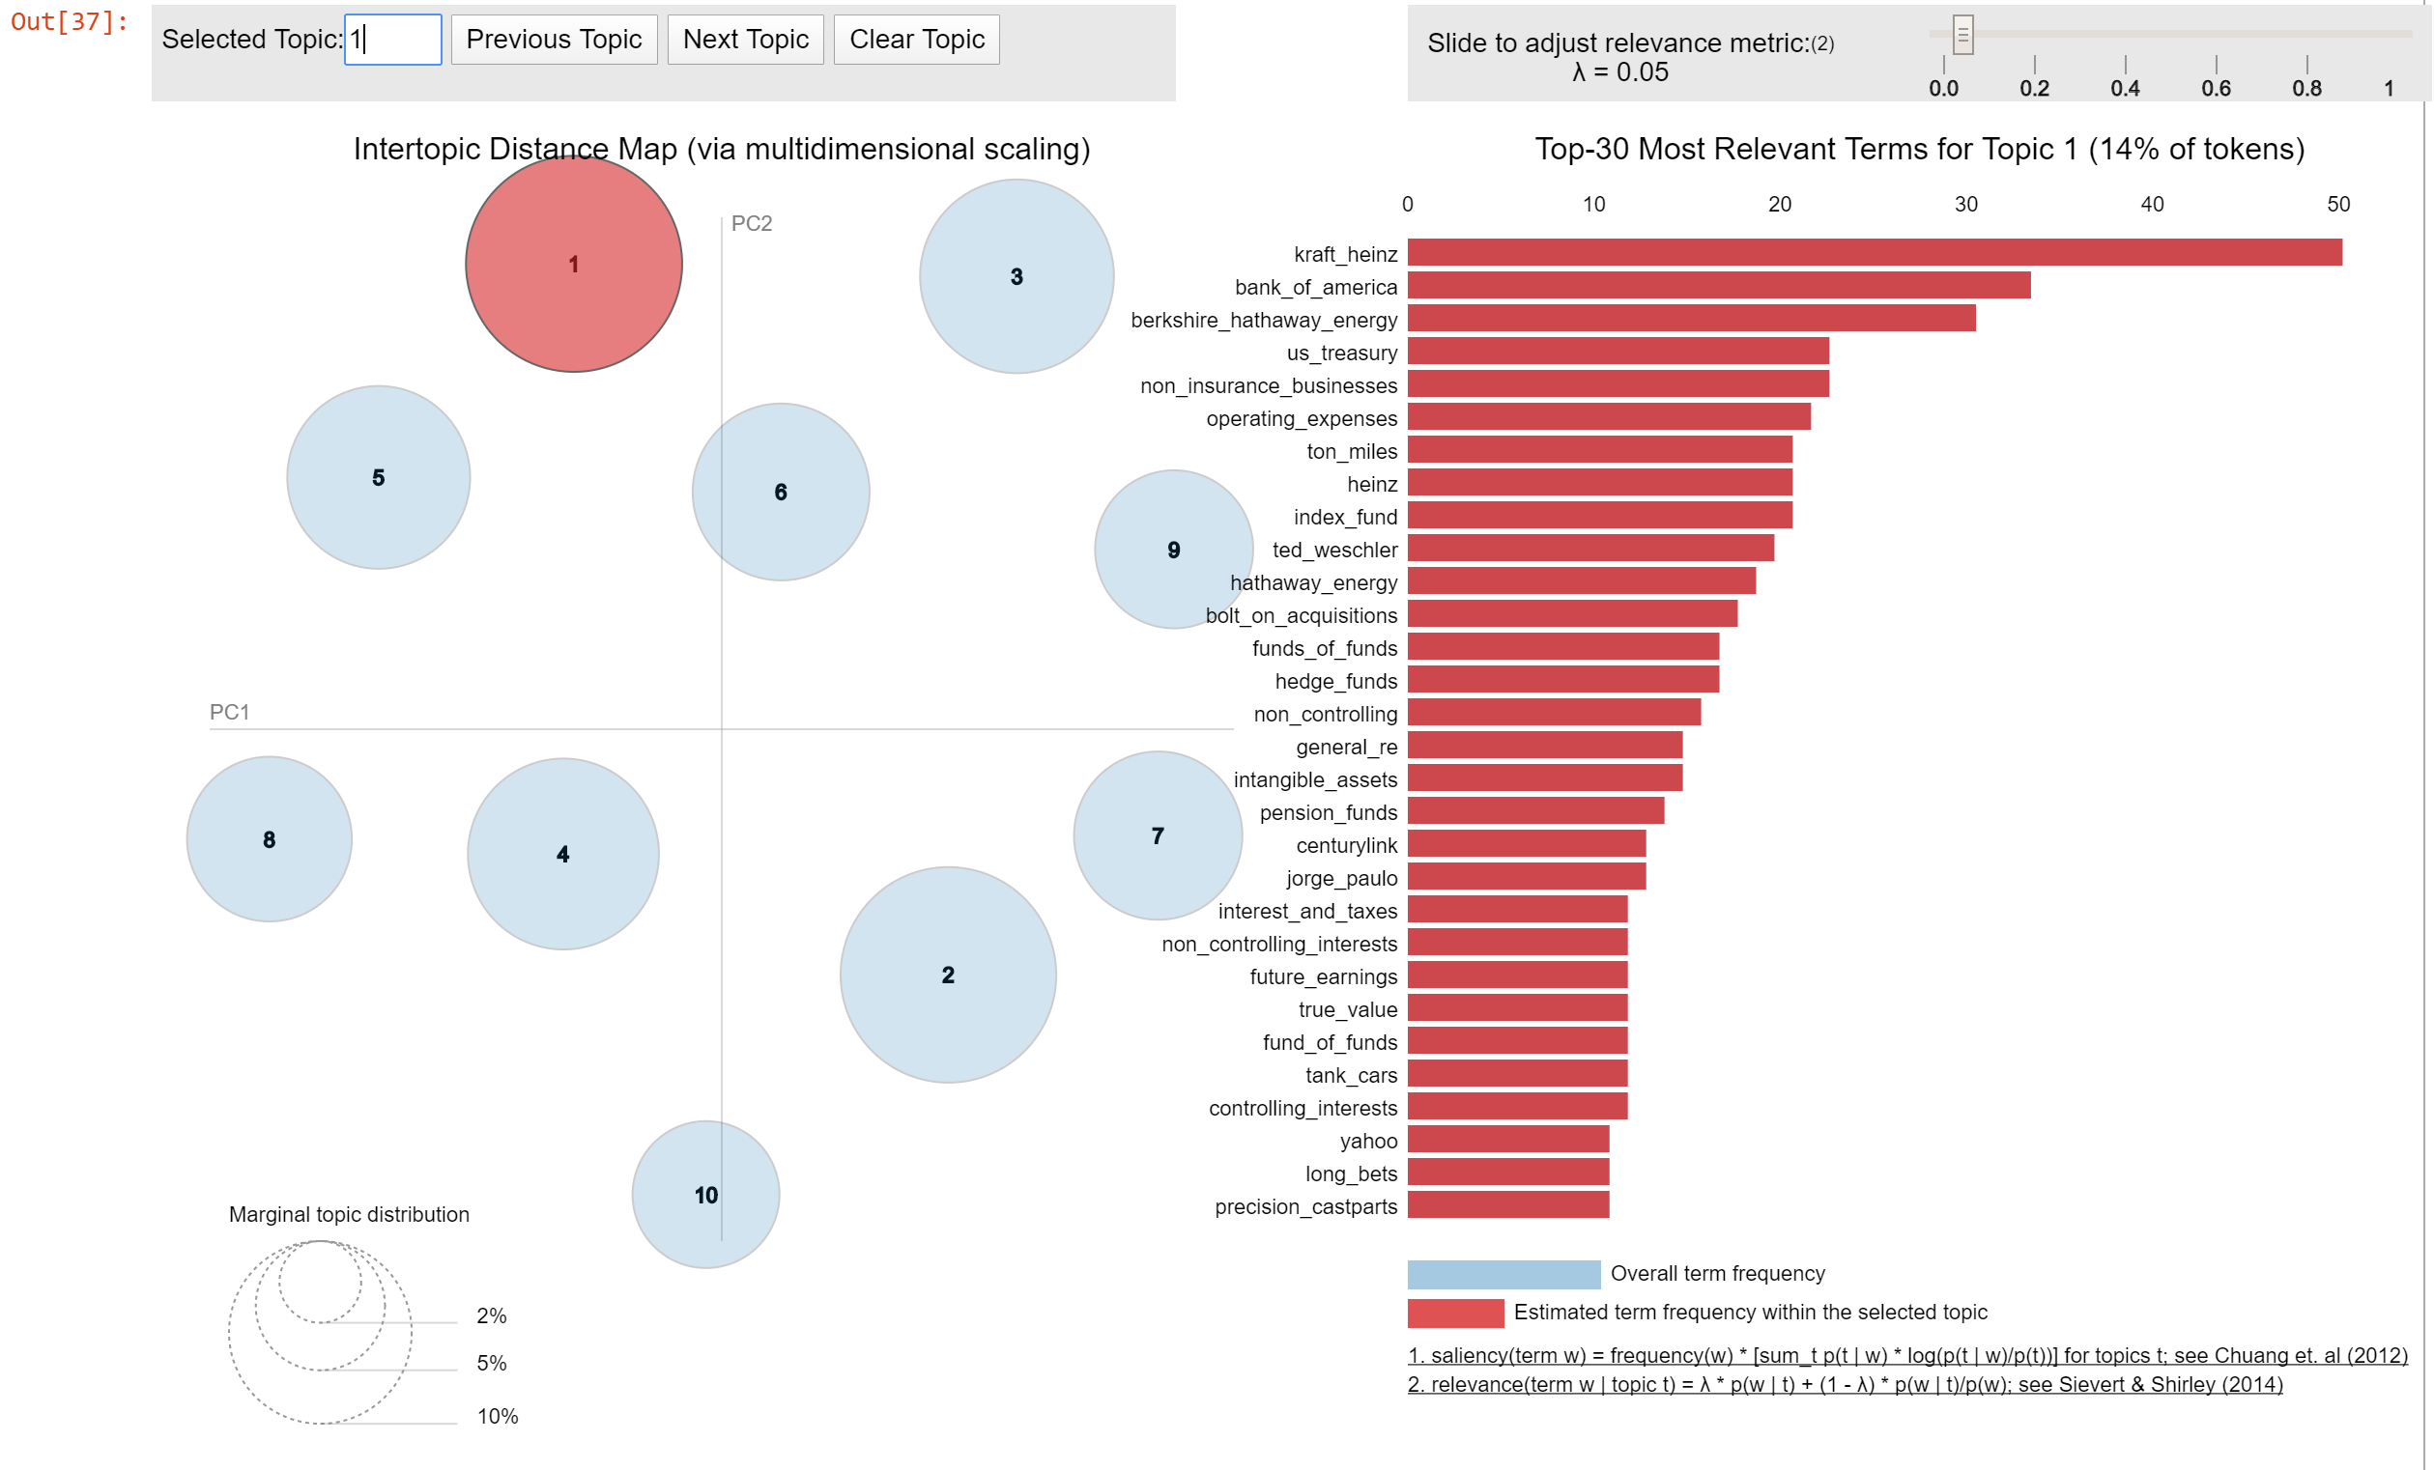
Why MalletLDA is Better

Slide 21
Mallet Topic Words (Lambda = .05)
Topic 1 | Topic 2 | Topic 3 | Topic 4
Wesco Financial | Ralph Schey | Fractional Ownership | WPPSS
Illinois National | Scott Fetzer's | General Re | News
Earnings Per Share | Ralph | September 11th | Courier Express
Phil Liesche | Fechheimer | Executive Jet | The News
National Bank | Chuck | Owners Manual | Stan
Topic 5 | Topic 6 | Topic 7 | Topic 8
Kraft Heinz | Major Investees | Non-controlled | BNSF
Hathaway Energy | Cat Business | Good Businesses | Marmon
Fund of Funds | Super Cat Business | Controlled Businesses | Operating Expenses
Hedge Funds | Geico's | Buffalo Evening | ton miles
Berkshire Hathaway Energy | Earnings Reported | Unusual Sales | Heinz
Topic 9 | Topic 10 | Topic 11 | Topic 12
R.C. Willey | HH Brown | General Res | Stock Prices
New Jersey | Cost of Funds | Compounded annually | Contingency Reserve
Growth Rate | Preferred Stock | Black Scholes | Berkshire System
Electric Customers | H Brown | Kern River | Board of Directors
Qwest | RJR Nabisco | General Electric | Years Later

Slide 22
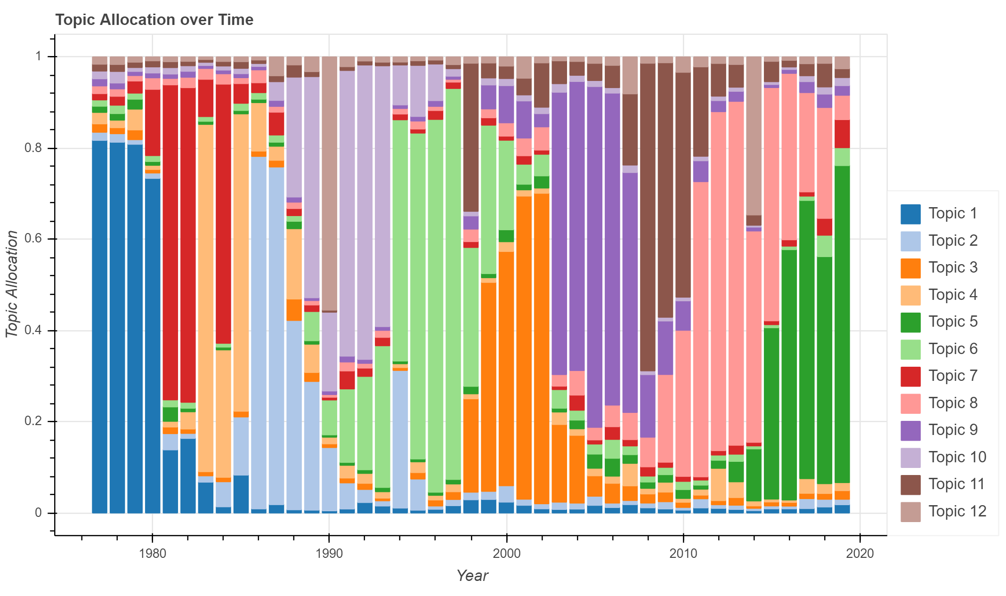

Slide 23
Conclusion – Annotating the Topics
Topic 1: Early Holdings: Banks and Stamps
Topic 2: Scott Fetzer Company
Topic 3: Aviation Businesses
Topic 4: Bond Defaults and Newspapers
Topic 5: Massive Funds and Businesses
Topic 6: Insurance Underwriting
Topic 7: Insurance Companies
Topic 8: Industrial Holdings
Topic 9: Annual Meeting at the Qwest
Topic 10: Cowboy Boots, Junk Bonds and Mortgages
Topic 11: Electricity and Reinsurance
Topic 12: US Steel

Slide 24
Next Steps
Applying techniques to new documents (10-K)
Deep learning and abstractive summarization
Sentiment Analysis
Special thanks to Liang Kuang from Springboard for his assistance and mentorship.

